Slide 1
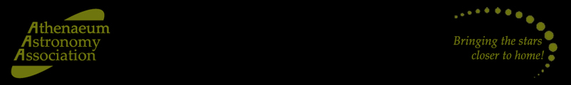
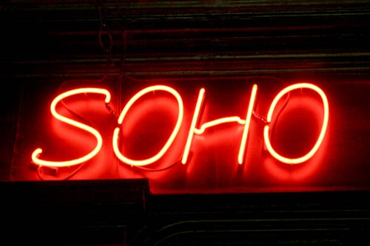
Mark Proctor, 31 August, 2017

Slide 2
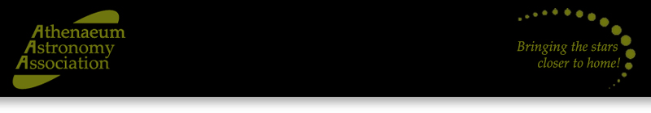
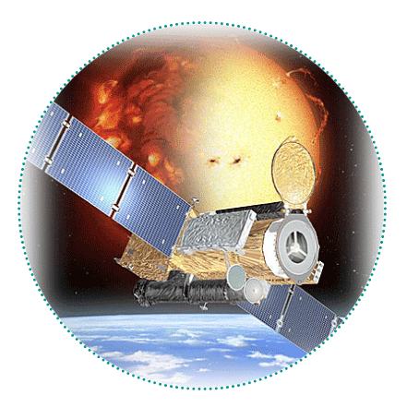

What is SOHO?
Solar and Heliospheric Observatory
Heliosphere - the region of space,
encompassing the solar system, in which the solar wind has a significant influence
Satellite monitoring the Sun’s activity
22 years-old this December
Co-funded NASA/ESA mission

Slide 3
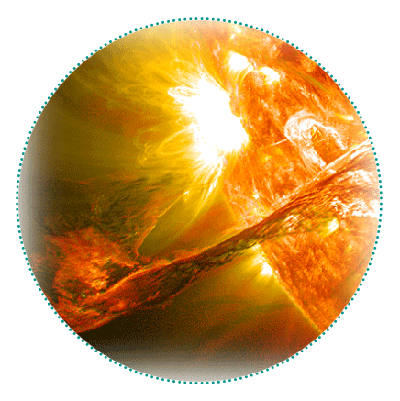
Why spy on The Sun?
A relatively stable, life-giving star
But also a volatile and active ball of gas
Flares, storms, eruptions and disruption to satellites and power, eg Quebec, 1989,
6 million powerless for 9 hours
Undefined potential biological, climatic
and economic risks and costs
Need to better understand solar activity and predict ‘space weather’

Slide 4
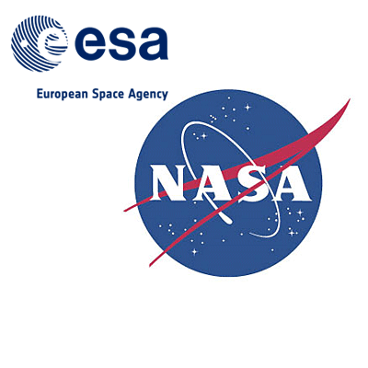
How did SOHO happen?
$1.27 billion financial and research collaboration
Launched from Cape Canaveral in 1995
‘Piggy-backed’ on an Atlas II rocket
Two hours to intermediate ‘transfer orbit’
Four months to final destination orbit around the Lagrange L1 point
Lagrange L1 point – an area in space where the gravity of The Sun and The Earth balance each other out

Slide 5
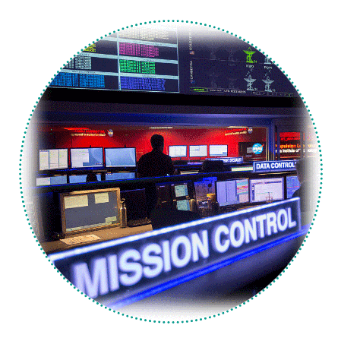
In a spin
June 1998 – loss of control and access at
start of extended mission
‘Calamitous sequence of events’ during
routine gyroscope calibration
No control over altitude, telemetry,
power, thermal dynamics
Baked, frozen and thawed
Arecibo to the rescue
Gyroscopic replacement

Slide 6
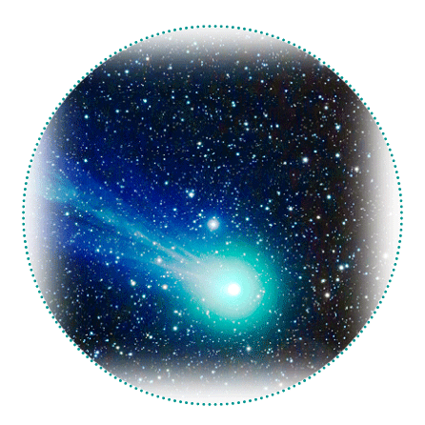
Back on track
Extra week’s notice of solar eruptions to
storm watchers
See the ‘dark side’ of The Sun, sense and predict activity though ultra-violet
emissions
Analyse sub-surface gas currents, solar
wind constituent elements
Understand, predict and mitigate coronal
mass ejections
Unplanned outcome for comet hunting!

Slide 7

Thank you – any questions?
Ask Daniel ☺

